Slide 1

Recurrent Neural Networks (RNN)
Mayank Anand
mayankanand2701@gmail.com

Slide 2

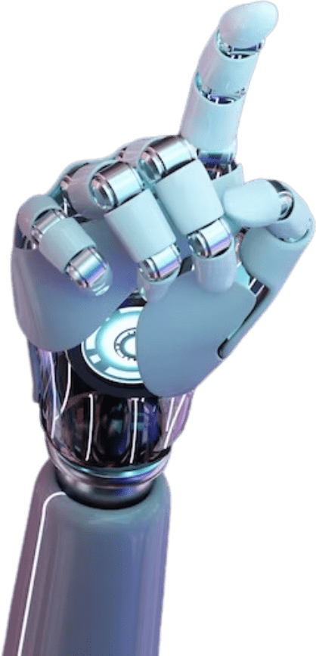
02
Introduction
Recurrent Neural Networks (RNNs) are a type of neural network designed to process sequential data. They maintain a hidden state, allowing them to retain information from previous inputs, making them suitable for tasks like speech recognition and time series forecasting. RNNs excel at handling variable-length inputs and temporal dependencies.

Slide 3
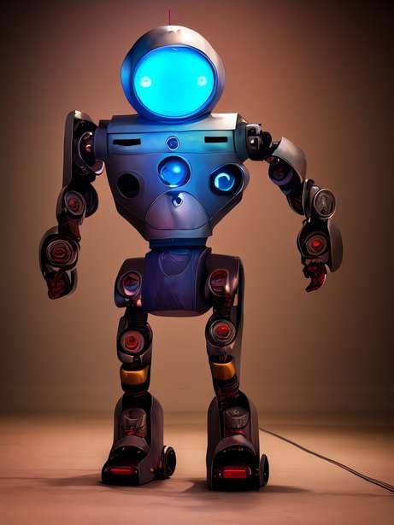


03
Evolution of RNN
Recurrent Neural Networks (RNNs) were introduced in the 1980s by John Hopfield and later refined by researchers like David Rumelhart. Early RNN models faced challenges, such as the vanishing gradient problem, limiting their effectiveness. The development of Long Short-Term Memory (LSTM) networks by Hochreiter and Schmidhuber in 1997 addressed these issues, making RNNs practical for tasks involving sequential data, like speech and language modeling.

Slide 4
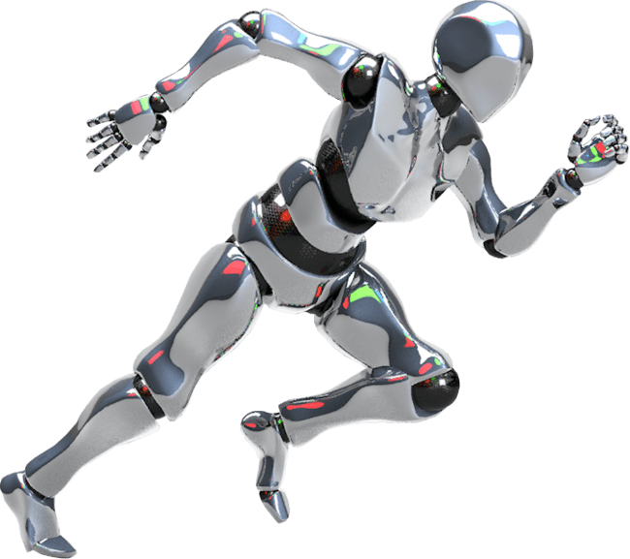
04
Features of RNN
Sequential Processing : Processes sequences of data one step at a time.
Hidden State : Stores information about previous inputs.
Weight Sharing : Same weights applied at each step, reducing model complexity.
Can handle variable-length input sequences.

Slide 5

05
Advantages of RNN
Captures Temporal Dependencies : Ideal for tasks with time-based relationships.
Handles Variable Input Lengths : Suitable for text, audio, and time series data.
Memory of Past Inputs : Useful for language models, speech recognition.

Slide 6
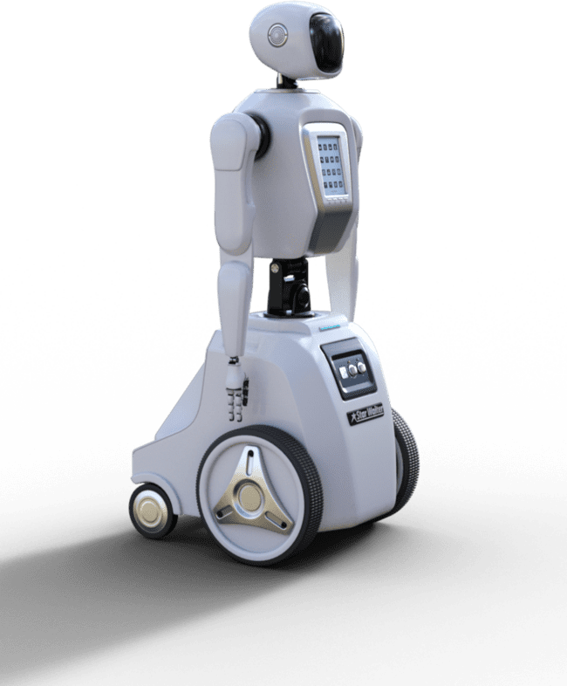
06
Disadvantages of RNN
Vanishing/Exploding Gradient Problem : Struggles with long sequences.
Slow Training : Computationally expensive due to backpropagation through time.
Short-term Memory : Difficulty in learning long-term dependencies.

Slide 7


07
Real-Life Applications
of RNN
Speech Recognition : Converting audio into text (e.g., Siri, Google Assistant).
Natural Language Processing (NLP) : Machine translation, text generation, sentiment analysis.
Stock Market Prediction : Predicting future trends based on historical data.
Time Series Forecasting : Weather prediction, financial analysis.

Slide 8
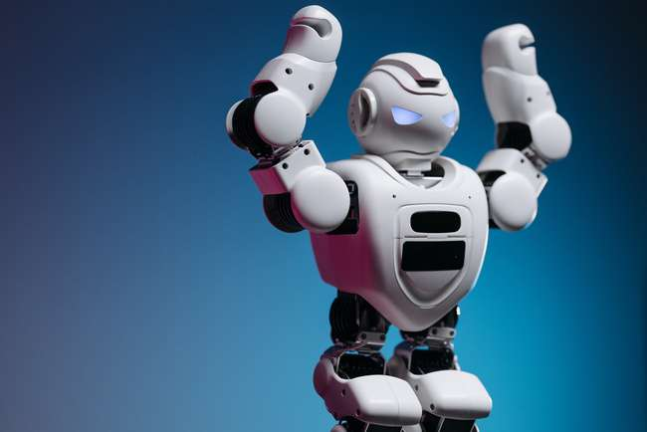
08
Conclusion
RNNs are powerful for sequential data processing.
Strength in short-term memory but struggles with long-term dependencies.
Applications in multiple domains like NLP, speech recognition, and forecasting.
Enhanced by variants like LSTM and GRU to mitigate limitations.

Slide 9
Thank You!
Thank you for exploring the world of AI with me.

